Slide 1
Sitecore Pathfinder
Get started, get far, get happy!
Notes:
Hi, this is Jakob, I am going to show a fun experiment, I have been working on, called Pathfinder.

Slide 2

New Sitecore toolchain
Sitecore Pathfinder
Build Sitecore website using favorite tools and a familiar approach
From project directory to website
Old habits die hard
Notes:
Pathfinder is a new toolchain for building Sitecore website. Basically the toolchain create a deliverable package from the source files in a project directory and deploy the package to a website where an installer installs all the new files and Sitecore item into the website.
It is a big goal that you can use your favorite tools in a way, that is very familiar. The most obvious thing, you will see, is that you no longer have to use Visual Studio. You still can, of course, if you like.
The new toolchain will take you from your project directory all the way to the website, so deployment is a also part of the toolchain – although only on a smaller scale.
If you are used to using Visual Studio, SIM, TDS, Rocks, and all the other great Sitecore tools out there, Pathfinder should work great with them, but you as a developer will probably have to change some of your habits – which is always hard. Specifically in Pathfinder items are now files, which may take some getting used to.

Slide 3
Goals
Make it easier to develop Sitecore website
Lower tooling requirements
Checking
Deployment
Notes:
So, the goal of Pathfinder is to make it easier to build Sitecore website for developers – especially for new developers. Sitecore is not particular difficult to work with, but it can have steep learning curve.
And there are many way to do this – Sitecore comes with a lot of quirks – and there are parts of Sitecore that are very manual.
Pathfinder tries to solve some of these issues by doing a number of things – first by lowering the tool requirements. Sitecore developer often have a full Visual Studio with TDS, Rocks, Resharper and more. All these tools requires learning. Pathfinder makes it possible to develop website without Visual Studio.
If you look at what Microsoft is doing right now, they are providing support for their products in a lot of 3. party tools – the best example is TypeScript support in SublimeText, and they just released a preview of Visual Studio Code, which is a code editor very similar to SublimeText, and like SublimeText it is cross-platform. They are also adding support for Grunt and Gulp in VS2015. So there is clearly a move towards the front-end and web development way of developing.
One of the things that Pathfinder does, is that it has checking step. This step runs through your project and checks for all sorts of issues. This is an really important and useful step, because Pathfinder can help you follow best practices and find bugs and errors.
Another step is deployment. As mentioned Pathfinder takes you from project directory to website, so there is a step that will package your project and install it on a website.

Slide 4
Pathfinder Compiler and Installer
Notes:
So what is Pathfinder? It has 2 parts. The first part, you can think of as a compiler that produces a package, and the second is a package installler that runs on a website.

Slide 5
Pathfinder compiler
Compiles source files into a deliverable package
Everything is a file (items, media, renderings, configs etc.)
Project contains the whole truth (and is separate from the website)
Compiler checks validity and ensures integrity
Command-line tool
Notes:
The purpose of the compiler is the take source files from a project directory and compile them into a deliverable package. The compiler runs on your development machine. Once the package has been compiled, it is copied to a website where the installer will install it.
The source files is everything that makes your project, including Sitecore items. Now this is important, everything in Pathfinder is a file – items, media files, renderings, layouts, config files. This makes it very similar to projects in Visual Studio or in SublimeText – your project is just a file directory. As you will see later, items files can be just Xml or Json files.
It is also important that your project directory contains the whole and single truth. If you think of a Visual Studio project, the project contains everything that is needed to build the application. In Sitecore your source is typically spread across development projects, Sitecore databases, websites – and that makes it really difficult to get a handle on. Tools like TDS and Rocks do make it easier.
But in Pathfinder, everything has to be in your project directory – and your project directory has to be separate from the website – no more having your project in the root of the website.
This approach allows Pathfinder to do very nice things – like running the checker process – and since it knows everything there is to know about the project, it can check a lot of things.
And in the end the Pathfinder compiler is just a command line tool, so you can execute it any way you like.

Slide 6
Pathfinder installer
Installs the deliverable package into a Sitecore website
Supports NuGet packages
Supports NuGet dependencies
Sitecore.Pathfinder.Core NuGet package
Notes:
When the compiler has compiled the project and copied the output package to the website, the installer takes over.
It purpose of it, is quite simple: It basically recompiles the project, and installs the files and items into the Sitecore website.
One of the future plans is to incorporate Anti-packages from Sitecore Rocks, so packages can be uninstalled, but that is for the future.
Currently Pathfinder uses Nuget packages, but it could be anything; Sitecore packages, upgrade packages, zips whatever.
But right now, we use Nuget packages, because they support dependencies. This means that one package can require another package to be installed first. And a Pathfinder package do have a dependency on the Sitecore.Pathfinder.Core package. This package tweaks Sitecore to be a little easier to work with.
It is really important to emphasize the dependencies, because this allows you to break down development of a website into smaller projects. One team is working on one part of a website, while another is working on a another – and they share their projects just by sharing the Nuget packages.

Slide 7
Projects
Notes:
So, how do you work with Pathfinder – as mentioned it is just a command-line tool.

Slide 8
Developer experience
Work with Sitecore items the same way you work with source code (including source control)
Edit source files
Compile
Check result
Repeat
Pathfinder can infer and implicitly create Sitecore items from media files, renderings and more
Notes:
The developer is experience is very classic, edit, compile, check, and repeat. This is how you work with source code – and since everything is a file, it should be very familiar.
Since you can think of Pathfinder as a compiler, it can do a number of things for you automatically. For instance when you are adding an image, you don’t have to upload it, or create a media item. You can drop the image in your project, and the compiler will figure the rest out for you. Same with renderings and layouts.
So Pathfinder tries to enable a very classic developer experience and an experience that is close to how front-end and web developments happens today. And it tries to remove some of the more tedious parts of developing.

Slide 9
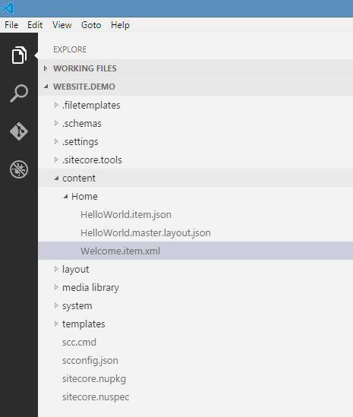
Project
Project has the whole and single truth
Code, assets and resources are not spread across Sitecore databases, websites, development projects etc.
A project is just a filesystem directory
Source control friendly
Notes:
In typical web project, the project is just file directory with files. As mentioned in Pathfinder your project contains the whole and single truth, so the compiler can check the project.
This makes it very source control friendly.

Slide 10
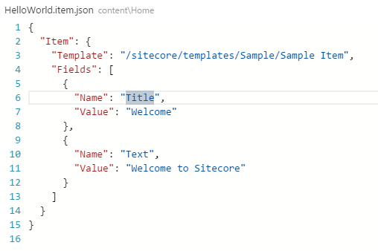
Items
Items are just files
Format agnostic
Json
Xml
Serialized items (not human editable)
Items are created in the project as files – not in the Content Editor (or Sitecore Rocks)
Notes:
Items are just files. On the right, you can see an item written in Json. It is quite straight forward.
Pathfinder does not really care about the format, because you need parsers to parse the source files. Currently Pathfinder has support for Json, Xml and serialized items, but hopefully it will be able to support formats like Markdown or just plain flat files in the future.
Since the project needs the whole truth, you have to create your items as files. This means that you can no longer create items using the Content Editor or Rocks for that matter. This is going to be a hard habit to break, but when you think about is makes sense. This is how you build an application in the classical sense.

Slide 11
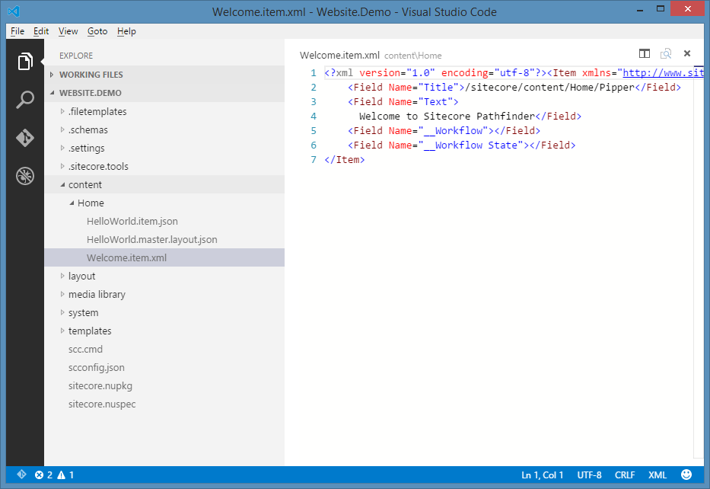
Editor agnostic
Use your favorite editor, e.g.
Notepad
Notepad++
SublimeText
Code
Visual Studio is not a requirement
Notes:
About tooling, since everything is just a file, you can use whatever text editor you want. On the right, you can see the new Code editor from Microsoft.
It is important that Visual Studio is not a requirement.

Slide 12
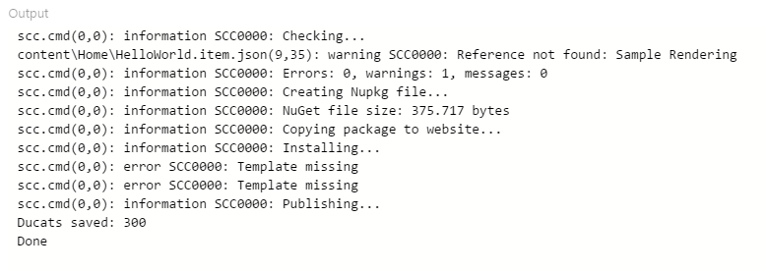
Build process agnostic
Use any modern build process
GruntJS
GulpJS
MSBuild
Command line
Continuous integration friendly
Notes:
Same with build process. The compiler is just a command line tool, so it can easily be integrated into your favorite build tool. And it can be run as part of a continueos integration process.
You don’t need a build tool, you can also just run the compiler by it self from the command line.

Slide 13
Deploying
Deploying is part of the build process
Supports project dependencies through NuGet dependencies
Notes:
Pathfinder has a really simple deployment process where it just copies the Nuget package from the development folder to the website folder, where the installer takes over.
None-the-less, you can hook into this process, and have it deploy the package file in any way that suits you.
Again I think it is important to point out that using Nuget packages allows you to have dependencies between projects. These dependencies are resolved when the project is installed on the website.

Slide 14
Extensibility
Pathfinder is extendable
MEF
Scripts (powered by Roslyn)
Open source
https://github.com/JakobChristensen/Sitecore.Pathfinder
Notes:
Finally, this is Sitecore, so everything is extendable.
Pathfinder uses MEF from Microsoft, you can xcopy an extension assembly to your tools folder, and Pathfinder will pick up.
You can also drop C# files into the tools folder and Pathfinder will use the Roslyn compiler to create an extension assembly that will be loaded through MEF.
And Pathfinder is open source, so go have a look at the source.

